Slide 1
how using dither reflects on the MSE

Slide 2
agenda
we have given quantizers and we want to check if adding uniform dist, quantize and then subtracted the uniform will give better performance than just quantizing
the bottom line is that it’s better with dither but only at bin size at the quantization that we don’t work with
by what I see, it seems to help only because the big quantization is away from the data dist and the dither just through it back to the data dist, with no connection of what it was on the data dist

Slide 3
best bin sizes per number of quantizer for data var = 1 (with modulo)
3: 1.6400000000000015,
4: 1.342000000000001,
5: 1.1866666666666676,
6: 1.0021428571428579,
7: 0.91375000000000073,
8: 0.83888888888888946,
9: 0.75650000000000084,
10: 0.66045454545454607,
11: 0.63333333333333375,
12: 0.57346153846153891,
13: 0.53500000000000059,
14: 0.51066666666666682,
15: 0.48218750000000021,
16: 0.4529411764705884,
17: 0.43416666666666703,
18: 0.41526315789473722,
19: 0.38925000000000054,
20: 0.36142857142857165,
21: 0.36818181818181861,
22: 0.34456521739130475,
23: 0.3266666666666671,
24: 0.31840000000000046,
25: 0.30692307692307708,
26: 0.28555555555555578,
27: 0.28392857142857153,
28: 0.27741379310344838,
29: 0.26583333333333359,
30: 0.25983870967741973,
31: 0.24562500000000043,
32: 0.2360606060606063,
33: 0.23573529411764715,
34: 0.21785714285714297,
35: 0.22208333333333341,
36: 0.21310810810810832,
37: 0.21381578947368451,
38: 0.20243589743589752,
39: 0.18800000000000017

Slide 4
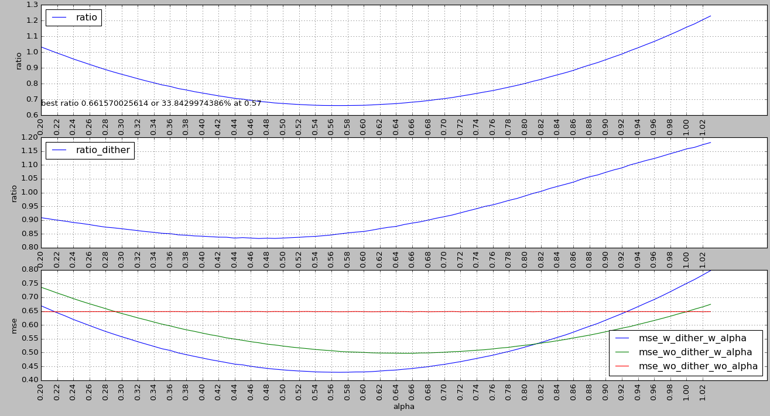
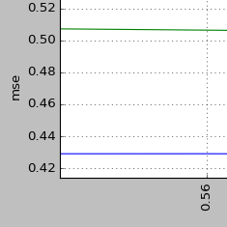
bin size = 3 (without modulo)

Slide 5
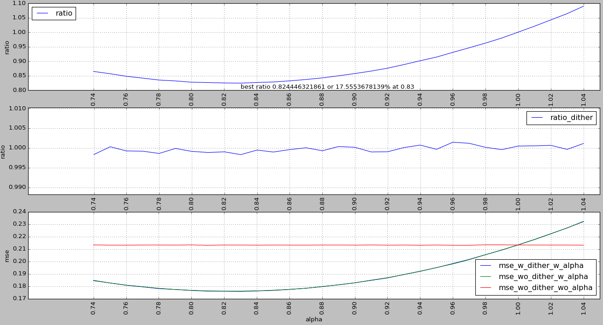
bin size = 1.6

Slide 6
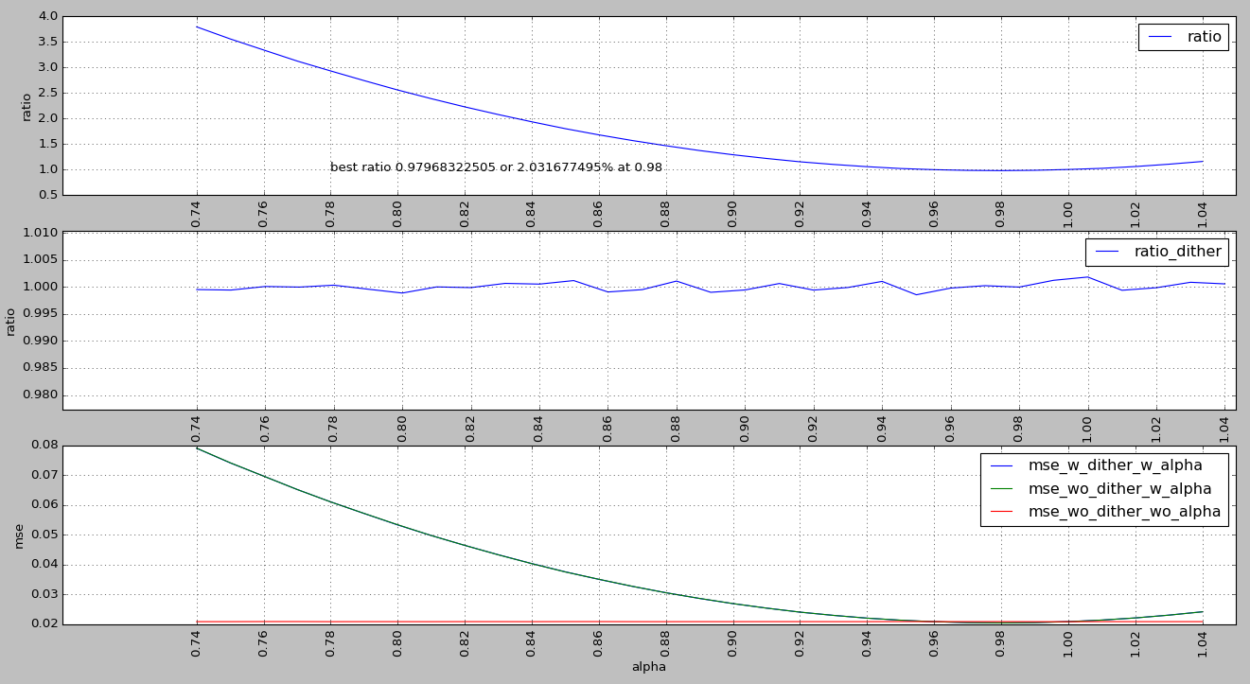
bin size = 0.5

Slide 7
python code
from numpy import *
import pandas as pd
import pylab
set_printoptions(precision=5)
min_alpha=0.74
min_alpha=0.2
max_alpha=1.04
##max_alpha=2
samples=4e6
samples=2e4
bin_size=1.6
##bin_size=0.5
##bin_size=3
class pc():
def __iter__(self):
return self.__dict__.iteritems()
def table(self):
data=pd.DataFrame([{k:v for k,v in dict(self).iteritems() if self.t(v)}])
#return data
return data.transpose()
def t(self,v):
try:
return size(v)<10
except:
return False
def qnt(bin_size,numbers):
ret=bin_size*rint(numbers/bin_size)
return ret
def calc_mse(est,real):
e=est-real
return e*e.T/e.size
class fl(pc):
def __init__(self,alpha):
self.alpha=alpha
self.s=samples
## self.s=1.0
self.bin_size=bin_size
self.var_x=1.0
self.x=mat(random.normal(0,sqrt(self.var_x),self.s))
self.u=mat(random.uniform(-self.bin_size/2,self.bin_size/2,self.s))
## self.u=0
self.x_qnt_without_dither=qnt(self.bin_size,self.x)
self.x_with_u=self.x+self.u
self.x_qnt_with_dither=qnt(self.bin_size,self.x_with_u)-self.u
self.mse_wo_dither_wo_alpha=calc_mse(self.x_qnt_without_dither,self.x)
self.mse_wo_dither_w_alpha=calc_mse(self.x_qnt_without_dither*self.alpha,self.x)
self.mse_w_dither_w_alpha=calc_mse(self.x_qnt_with_dither*self.alpha,self.x)
self.ratio=self.mse_w_dither_w_alpha/self.mse_wo_dither_wo_alpha
self.ratio_dither=self.mse_w_dither_w_alpha/self.mse_wo_dither_w_alpha
#run sim:
d=pd.concat([fl(i).table() for i in arange(min_alpha,max_alpha,0.01)],axis=1).transpose().reset_index()
#results:
def on_subplot():
pylab.xlabel('alpha')
pylab.grid()
pylab.legend(loc="best")
pylab.xticks(arange(min_alpha,max_alpha,0.02),rotation=90)
pylab.title("bin size = "+str(bin_size))
pylab.subplot(3,1,1)
pylab.plot(d["alpha"],d["ratio"],label="ratio")
min_ratio=d.iloc[d['ratio'].idxmin()]
pylab.text(min_alpha,min_ratio['ratio'],"best ratio "+str(min_ratio['ratio'].A1[0])+" or "+str((1-min_ratio['ratio'].A1[0])*100.0)+"% at "+str(min_ratio['alpha']))
on_subplot()
pylab.ylabel('ratio')
pylab.subplot(3,1,2)
pylab.plot(d["alpha"],d["ratio_dither"],label="ratio_dither")
on_subplot()
pylab.ylabel('ratio')
pylab.subplot(3,1,3)
pylab.plot(d["alpha"],d["mse_w_dither_w_alpha"],label="mse_w_dither_w_alpha")
pylab.plot(d["alpha"],d["mse_wo_dither_w_alpha"],label="mse_wo_dither_w_alpha")
pylab.plot(d["alpha"],d["mse_wo_dither_wo_alpha"],label="mse_wo_dither_wo_alpha")
on_subplot()
pylab.ylabel('mse')
pylab.show()

